Slide 1
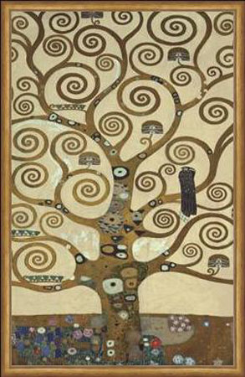
Phylogenetics
December 2023
Gustav Klimt 1905 “Tree of Life”

Slide 2
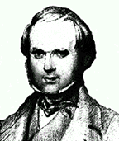
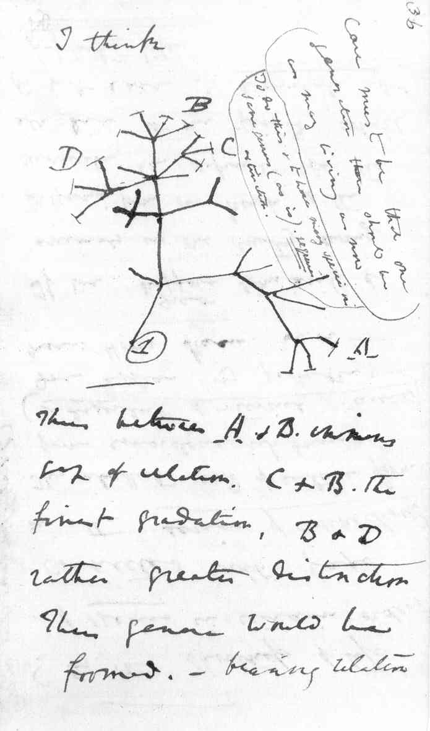
Notebook around July 1837

Slide 3
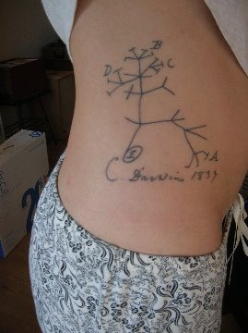

Slide 4
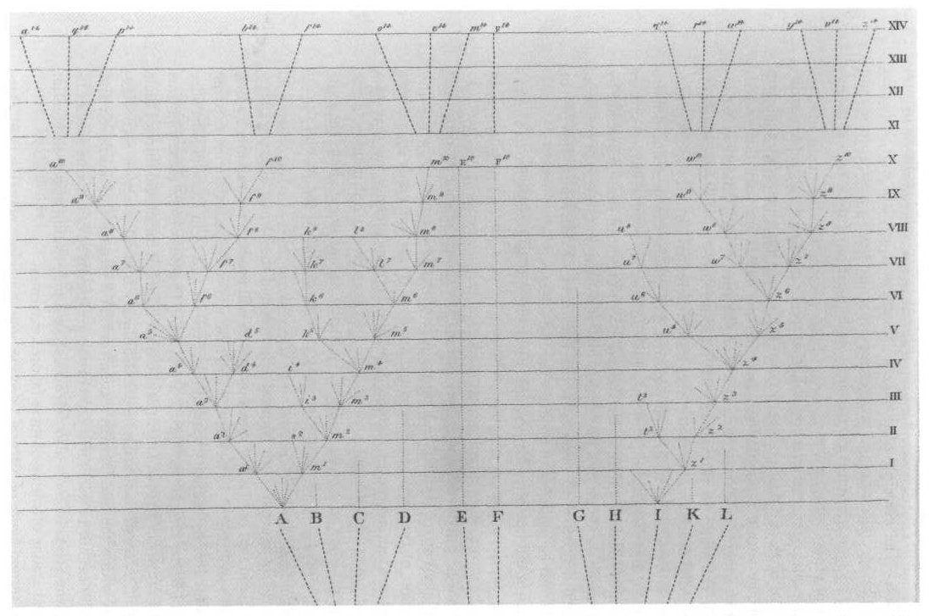

Slide 5
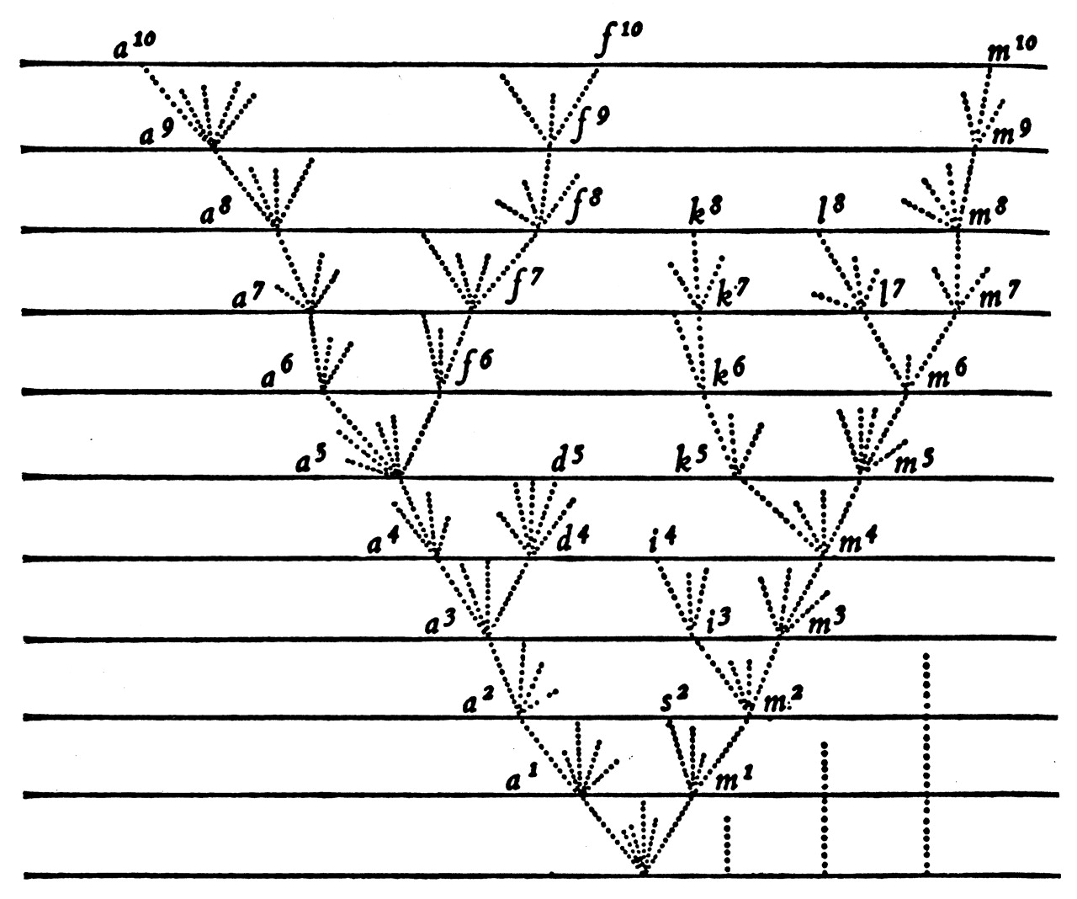
Detail from only figure in origin of species
Darwin 1859

Slide 6
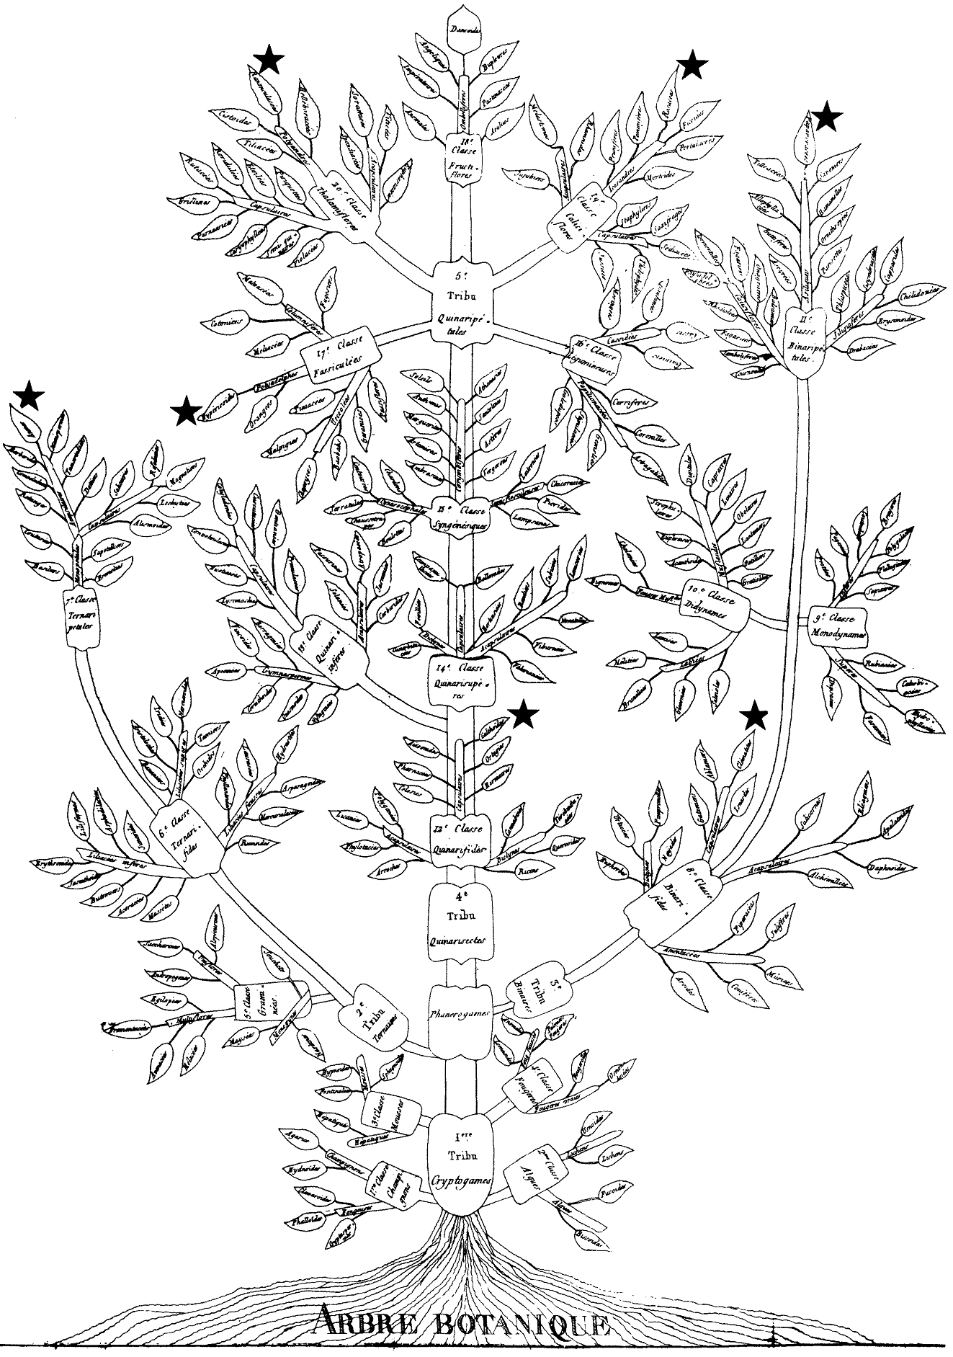
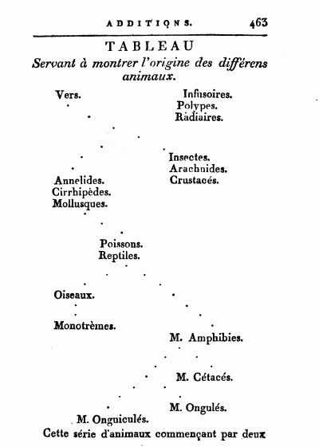
Augustin Augier 1801
Jean-Baptiste Lamark 1809

Slide 7
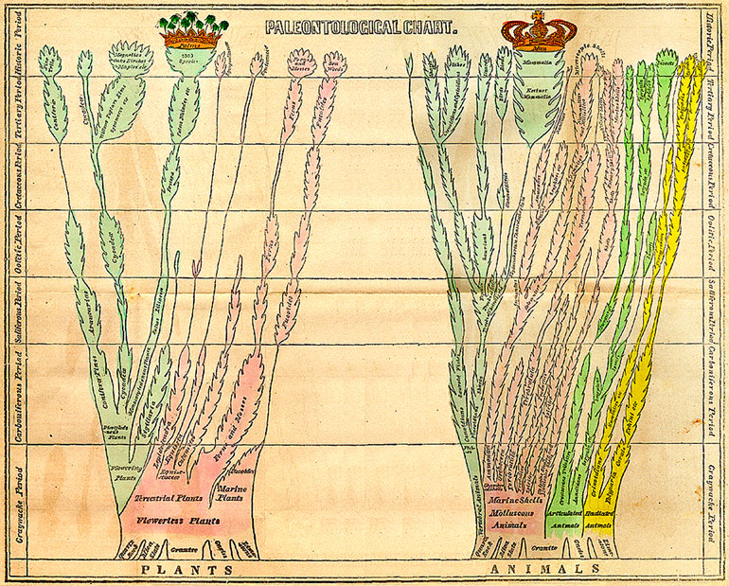
Elementary Geology Edward Hitchcock (1840)

Slide 8
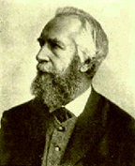
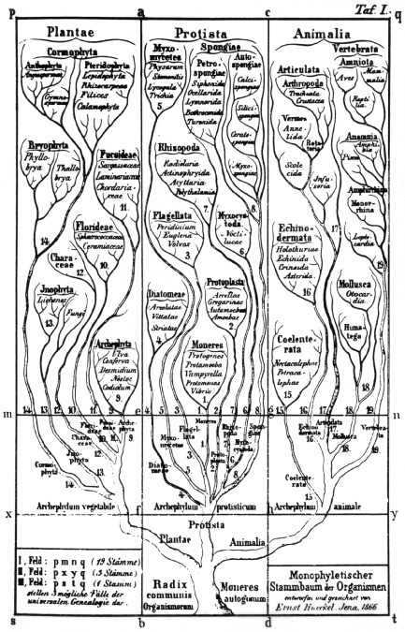
Ernst Haeckel MD.PhD.
(1834-1919)
- “ontogeny recapitulates phylogeny”
coined words “protista”, “phylum”,
“ecology”, “phylogeny”
TREE OF LIFE

Slide 9
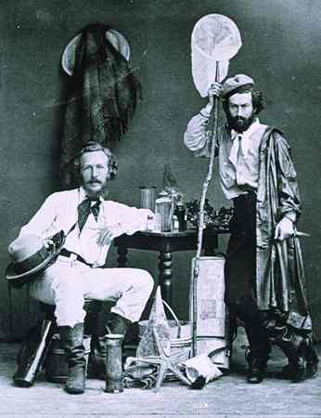
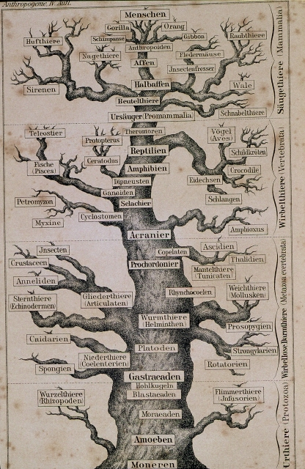
1866
The Evolution of Man (1879)

Slide 12
Taxon
Node
Branch
Root

Slide 13
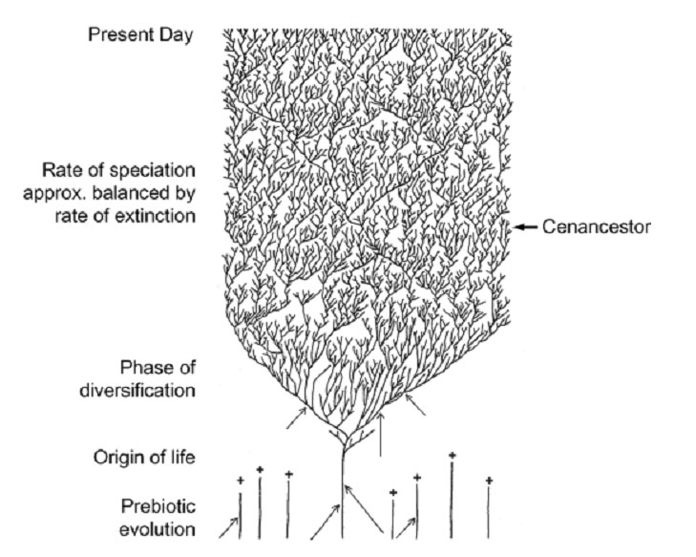

Slide 14
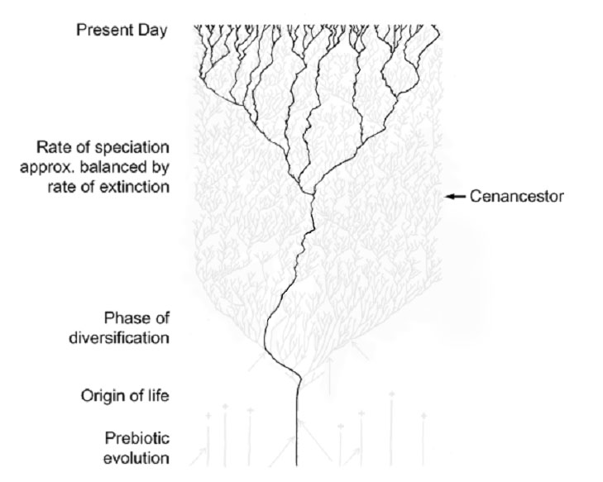

Slide 15
Look Different but Same Topologies
Time

Slide 16
What about branch length:
Branch length can signify many different things (time, difference, inferred changes)
General rule: longer branch length indicates more evolutionary change

Slide 17
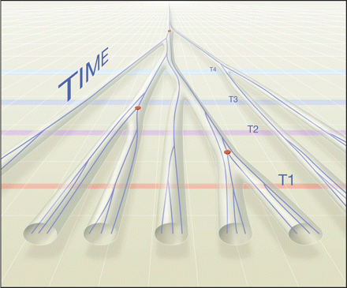

Slide 18
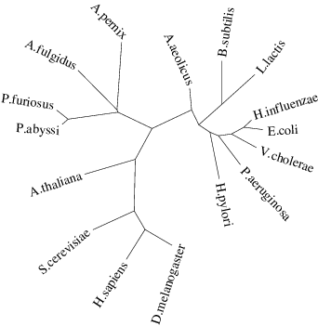
UNROOTED TREES

Slide 19
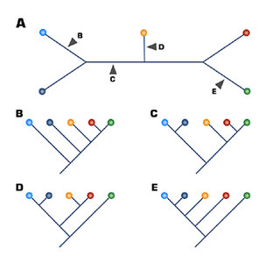

Slide 23
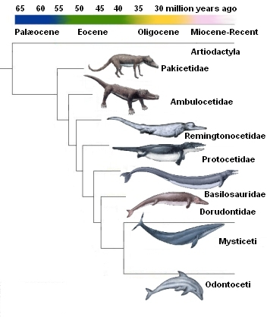
How do you decide how to root a phylogeny?
Use an outgroup:
The best outgroup is a taxon that is a close relative that you are pretty sure is not in the ingroup.
The more outgroups the better.
The branch of the outgroup becomes the root.
Character polarity
Polarity is the direction of evolutionary change (ie., forelimb evolves into wing)
Make sure that the topology has all of the assumed polarities going in the right direction.

Slide 24
What info is in a tree?

Slide 25
What info is in a tree?
Closest Relatives

Slide 26
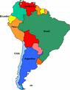

What info is in a tree?
Closest Relatives/Biogeography

Slide 27
What info is in a tree?
Change on branches
Evolutionary Direction/Polarity

Slide 28
Hypothetical Ancestors

Slide 29
Rat ATGGATCGTCTATTGTA
Mouse ATGGATCGTCTATTGTA
Human ATGGATCGTCTATTGTA
Lizard ATGGGTCGTCTATTGTA
Fly ATGGGTCGTCTATTGTA
Rat
Mouse
Human
Lizard
Fly

Slide 30
Rat ATGGATCGTCTATTGTA
Mouse ATGGATCGTCTATTGTA
Human ATGGATCGTCTATTGTA
Lizard ATGGGTCGTCTATTGTA
Fly ATGGGTCGTCTATTGTA
Rat
Mouse
Human
Lizard
Fly

Slide 31
FITCH OPTIMIZATION
A
A
A
G
G
A
A
3A v G =
A
A/G
A
G
G
G
G
Rat ATGGATCGTCTATTGTA
Mouse ATGGATCGTCTATTGTA
Human ATGGATCGTCTATTGTA
Lizard ATGGGTCGTCTATTGTA
Fly ATGGGTCGTCTATTGTA

Slide 32
FITCH OPTIMIZATION
A
A
A
G
G
A
A
G
A to G
G
Disclaimer: There are other more complicated statistical methods for this using maximum likelihood and Bayesian analysis but I did not think it was necessary to make you integrate!

Slide 33
How to make a tree from scratch starting with this sequence:
Human ACTCCAATGATAAATTTATAGTGGTGGAGCGCAATAAGAAATCACTGACAACTTCAC

Slide 34
Find Homologs and Align
Human ACTCCAATGATAAATTTATAGTGGTGGAGCGCAATAAGAAATCACTGACAACTTCAC
Chimp ATTCAAATGGTAAATTTGTAGTAGTGGAACGCGAGAAAAAATCACTTACAACGTCAC
Chimp2 AAATCATTTCTGAGACATTATGGGATAATGGGTTTGGTAAAACAATTCATGCACAGG
Gorilla ATTCAAATGGTAAATTTGTAGTAGTGGAACGCGAGAAAAAATCACTTACAACTTCAC
Gorilla2 AAATCATTTCTGAGACATTATGGGATAATGGGTTTGGTAAAACAATTCATGCACAGG
Gibbon AAACTCCAAATAAATATGTTGTAGTAAAACGAGAAAAGAAAAGTGTTTCAGATTCTA
Siamang ATATTGAGGATAAATTCATTGTTGTAGAACGTACAAAAAAATCTATAAATACAACTC
Human2 AAAATCCAGATAAATATATAGTAATAAAGCGTGAAAAGAAAAGCATATCAGATTCAA
Lucy AGACTGGTAATAAATTTATAGTTGTAGAACGTCAAAAAAGATCCCTTACAACATCAC
Macaca AAAATCCAGATAAGTTCATTGTGGTAAAACGTGAGAAGAAGAGTATTTCAGATTCCA

Slide 35
Find Homologs and Align
Human ACTCCAATGATAAATTTATAGTGGTGGAGCGCAATAAGAAATCACTGACAACTTCAC
Chimp ATTCAAATGGTAAATTTGTAGTAGTGGAACGCGAGAAAAAATCACTTACAACGTCAC
Chimp2 AAATCATTTCTGAGACATTATGGGATAATGGGTTTGGTAAAACAATTCATGCACAGG
Gorilla ATTCAAATGGTAAATTTGTAGTAGTGGAACGCGAGAAAAAATCACTTACAACTTCAC
Gorilla2 AAATCATTTCTGAGACATTATGGGATAATGGGTTTGGTAAAACAATTCATGCACAGG
Gibbon AAACTCCAAATAAATATGTTGTAGTAAAACGAGAAAAGAAAAGTGTTTCAGATTCTA
Siamang ATATTGAGGATAAATTCATTGTTGTAGAACGTACAAAAAAATCTATAAATACAACTC
Human2 AAAATCCAGATAAATATATAGTAATAAAGCGTGAAAAGAAAAGCATATCAGATTCAA
Lucy AGACTGGTAATAAATTTATAGTTGTAGAACGTCAAAAAAGATCCCTTACAACATCAC
Macaca AAAATCCAGATAAGTTCATTGTGGTAAAACGTGAGAAGAAGAGTATTTCAGATTCCA

Slide 36
Align Homologs
Human ACTCCAATGATAAATTTATAGTGGTGGAGCGCAATAAGAAATCACTGACAACTTCAC
Chimp ATTCAAATGGTAAATTTGTAGTAGTGGAACGCGAGAAAAAATCACTTACAACGTCAC
Chimp2 AAATCATTTCTGAGACATTATGGGATAATGGGTTTGGTAAAACAATTCATGCACAGG
Gorilla ATTCAAATGGTAAATTTGTAGTAGTGGAACGCGAGAAAAAATCACTTACAACTTCAC
Gorilla2 AAATCATTTCTGAGACATTATGGGATAATGGGTTTGGTAAAACAATTCATGCACAGG
Gibbon AAACTCCAAATAAATATGTTGTAGTAAAACGAGAAAAGAAAAGTGTTTCAGATTCTA
Siamang ATATTGAGGATAAATTCATTGTTGTAGAACGTACAAAAAAATCTATAAATACAACTC
Human2 AAAATCCAGATAAATATATAGTAATAAAGCGTGAAAAGAAAAGCATATCAGATTCAA
Lucy AGACTGGTAATAAATTTATAGTTGTAGAACGTCAAAAAAGATCCCTTACAACATCAC
Macaca AAAATCCAGATAAGTTCATTGTGGTAAAACGTGAGAAGAAGAGTATTTCAGATTCCA
Find the best tree: that optimizes “some function”

Slide 37
Align Homologs
Human ACTCCAATGATAAATTTATAGTGGTGGAGCGCAATAAGAAATCACTGACAACTTCAC
Chimp ATTCAAATGGTAAATTTGTAGTAGTGGAACGCGAGAAAAAATCACTTACAACGTCAC
Chimp2 AAATCATTTCTGAGACATTATGGGATAATGGGTTTGGTAAAACAATTCATGCACAGG
Gorilla ATTCAAATGGTAAATTTGTAGTAGTGGAACGCGAGAAAAAATCACTTACAACTTCAC
Gorilla2 AAATCATTTCTGAGACATTATGGGATAATGGGTTTGGTAAAACAATTCATGCACAGG
Gibbon AAACTCCAAATAAATATGTTGTAGTAAAACGAGAAAAGAAAAGTGTTTCAGATTCTA
Siamang ATATTGAGGATAAATTCATTGTTGTAGAACGTACAAAAAAATCTATAAATACAACTC
Human2 AAAATCCAGATAAATATATAGTAATAAAGCGTGAAAAGAAAAGCATATCAGATTCAA
Lucy AGACTGGTAATAAATTTATAGTTGTAGAACGTCAAAAAAGATCCCTTACAACATCAC
Macaca AAAATCCAGATAAGTTCATTGTGGTAAAACGTGAGAAGAAGAGTATTTCAGATTCCA
Find the best tree: that optimizes “some function”
How many trees do I need to look through?
FOR UNROOTED TREES:
(2n-5)!/[2n-3(n-3)!]
FOR UNROOTED TREES:
(2n-3)!/[2n-2(n-2)!]

Slide 38
How tree building actually works.
A AAAAT
B AATTA
C TTTTA
D AATAT

Slide 39
Number of Taxa Number of Rooted Trees
3 3
4 15
5 105
6 945
7 10395
8 135135
9 2027025
10 34459425
11 654729075
12 13749310575
13 316234143225
14 7905853580625
15 213458046676875
16 6190283353629375
17 191898783962510625
18 6332659870762850625
19 221643095476699771875
20 8200794532637891559375
21 319830986772877770815625
22 13113070457687988603440625
23 563862029680583509947946875
24 25373791335626257947657609375
25 1192568192774434123539907640625

Slide 40
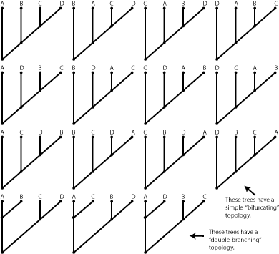
Align Homologs
Human ACTCCAATGATAAATTTATAGTGGTGGAGCGCAATAAGAAATCACTGACAACTTCAC
Chimp ATTCAAATGGTAAATTTGTAGTAGTGGAACGCGAGAAAAAATCACTTACAACGTCAC
Gorilla ATTCAAATGGTAAATTTGTAGTAGTGGAACGCGAGAAAAAATCACTTACAACTTCAC
Orang AAATCATTTCTGAGACATTATGGGATAATGGGTTTGGTAAAACAATTCATGCACAGG
4 taxa = 15 trees

Slide 41
Deciding which tree to pick: Optimality Criteria
Maximum Parsimony (what is the simplest explanation that accounts for all the data)
Maximum Likelihood (what is the highest likelihood of observing the data given a tree)
Bayesian (what is the highest probability that the tree is correct given the data)
Distance/Similarity (minimize the distance or group the most similar things together)

Slide 42
Tree-Building Methods
No explicit model
of sequence evolution
Explicit model
of sequence evolution
Application of the parsimony principle
pairwise comparison of sequences
Statistical approach
parsimony
distance
maximum likelihood
and bayesian

Slide 43
Align Homologs
A. Human ACTCCAATGATAAATTTATAGTGGTGGAGCGCAATAAGAAATCACTGACAACTTCAC
B. Chimp ATTCAAATGGTAAATTTGTAGTAGTGGAACGCGAGAAAAAATCACTTACAACGTCAC
C. Gorilla ATTCAAATGGTAAATTTGTAGTAGTGGAACGCGAGAAAAAATCACTTACAACTTCAC
D. Orang AAATCATTTCTGAGACATTATGGGATAATGGGTTTGGTAAAACAATTCATGCACAGG
4 taxa = 15 trees
9
9
10
9
9
8
5
4
Steps in red
9
9
9
9
12
13
15

Slide 44
Align Homologs
A. Human ACTCCAATGATAAATTTATAGTGGTGGAGCGCAATAAGAAATCACTGACAACTTCAC
B. Chimp ATTCAAATGGTAAATTTGTAGTAGTGGAACGCGAGAAAAAATCACTTACAACGTCAC
C. Gorilla ATTCAAATGGTAAATTTGTAGTAGTGGAACGCGAGAAAAAATCACTTACAACTTCAC
D. Orang AAATCATTTCTGAGACATTATGGGATAATGGGTTTGGTAAAACAATTCATGCACAGG
4 taxa = 15 trees
9
9
10
9
A
9
8
5
4
Steps in red
9
9
9
9
B
12
13
15

Slide 45
Align Homologs
A. Human ACTCCAATGATAAATTTATAGTGGTGGAGCGCAATAAGAAATCACTGACAACTTCAC
B. Chimp ATTCAAATGGTAAATTTGTAGTAGTGGAACGCGAGAAAAAATCACTTACAACGTCAC
C. Gorilla ATTCAAATGGTAAATTTGTAGTAGTGGAACGCGAGAAAAAATCACTTACAACTTCAC
D. Orang AAATCATTTCTGAGACATTATGGGATAATGGGTTTGGTAAAACAATTCATGCACAGG
4 taxa = 15 trees
9
9
10
9
9
8
5
4
Steps in red
9
9
9
9
12
13
15

Slide 46
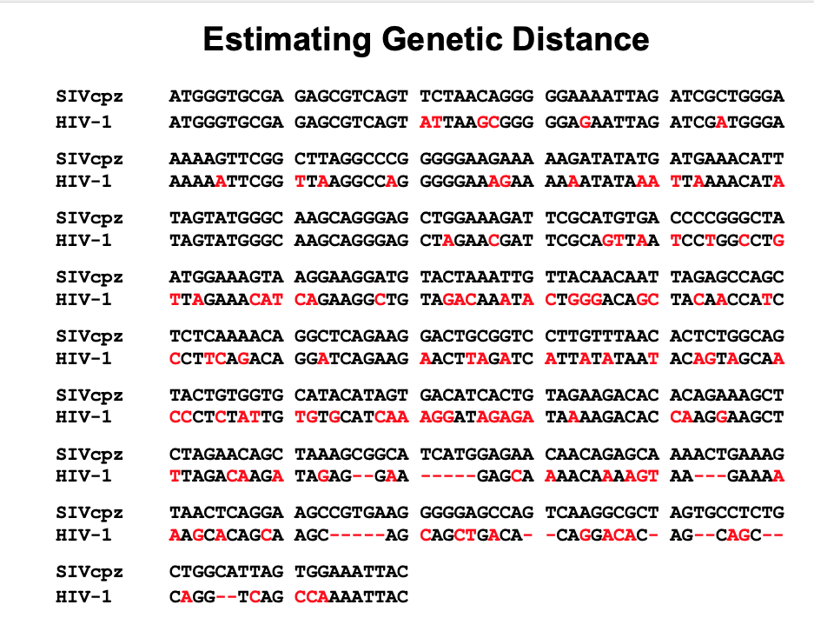

Slide 47
Models of DNA Substitution
• Models of DNA sequence evolution are required to recover the missing information through correcting for multiple substitutions.
The probability of substitution between bases
(e.g. A to C, C to T…)
ii. The probability of substitution along a sequence
(different sites/regions evolve at different rates)

Slide 48
A
α
C
α
α
α
α
T
G
α
All substitutions occur at the same rate (α)
Is this model too simple for real data?

Slide 49
A
β
C
α
β
β
α
T
G
β
Transitions (α) and transversions (β) occur at a different rate

Slide 50
Models of DNA Substitution
1. Base frequencies are equal and
all substitutions are equally likely
(Jukes-Cantor)
Simplest
(few parameters)
2. Base frequencies are equal but transitions and
transversions occur at different rates
(Kimura 2-parameter)
3. Unequal base frequencies and transitions and
transversions occur at different rates
(Hasegawa-Kishino-Yano)
Most complex
(many parameters)
4. Unequal base frequencies and all
substitution types occur at different rates
(General Reversible Model)
All these models can be tested using the program jMODELTEST
(darwin.uvigo.es/software/jmodeltest.html)

Slide 51
Models of DNA Substitution
The probability of substitution between bases
(e.g. A to C, C to T…)
ii. The probability of substitution along a sequence
(different sites/regions evolve at different rates)

Slide 52
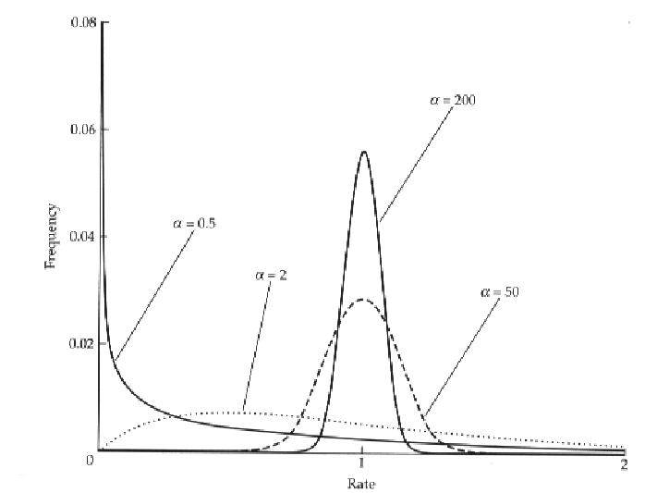
A Gamma Distribution Can be Used to Model Among-Site Rate Heterogeneity
Frequent among-site
rate variation
Little among-site
rate variation

Slide 53



Non-Parametric Bootstrapping
1
2 3
4
5
6
A
A A
A
A
A
C
C C
T
T
T
C
C C
C
C
G
T
T T
T
T
G
G
G A
A
A
A
G
G C
T
T
A
1
2 3
4
5
6
G
G A
A
A
A
G
G A
A
A
A
G
G C
T
T
A
A
A A
A
A
A
T
T T
T
T
G
C
C C
T
T
T
1
...
Resample with replacement multiple times
1
2
3
4
5
6
1
2 3
4
5
6
T
T T
T
T
G
G
G C
T
T
A
C
C C
C
C
G
C
C C
C
C
G
A
A A
A
A
A
G
G A
A
A
A
1000

Slide 54
LARGE-SCALE PHYLOGENETIC ANALYSIS
Genome Concatenation or Whole Genome alignments
SNP calling with reference to a matrix

Slide 55
LARGE-SCALE STANDARD PHYLOGENETIC ANALYSIS
Concatenation
Gene 1
Gene 2
Gene 3
Gene 4

Slide 56
LARGE-SCALE PHYLOGENETIC ANALYSIS
A CONCATENATED MATRIX
Final matrix has both variant and invariant positions.
Gene 1
Gene 2
Gene 3
… Gene n

Slide 57
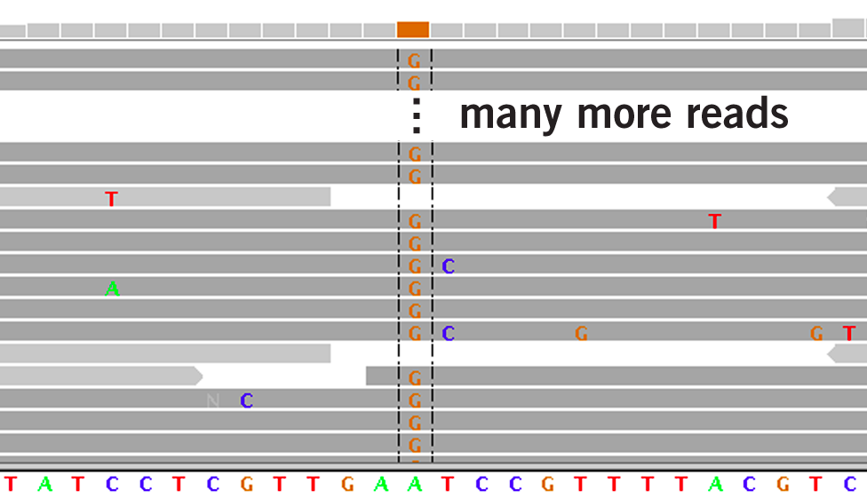
LARGE-SCALE PHYLOGENETIC ANALYSIS (Reference Based)
SNP Calling (final matrix has only invariant positions=danger ascertainment bias)

Slide 58
Things to think about when you look at a tree
How is it rooted?
What do the branch lengths mean?
Do the branch lengths make sense?

